Slide 1
Efficiently Automating Self-Assembled Quantum-Dot Nanofilm Image Segmentation
Wendy Slattery - Computer Science
Advisor: Dr. Karen Works
Florida State University
April 14, 2021
Notes:
This page should consist of only the relevant information for the study

Slide 2
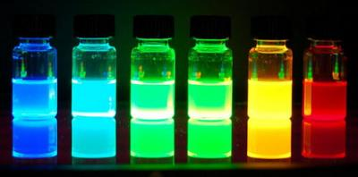
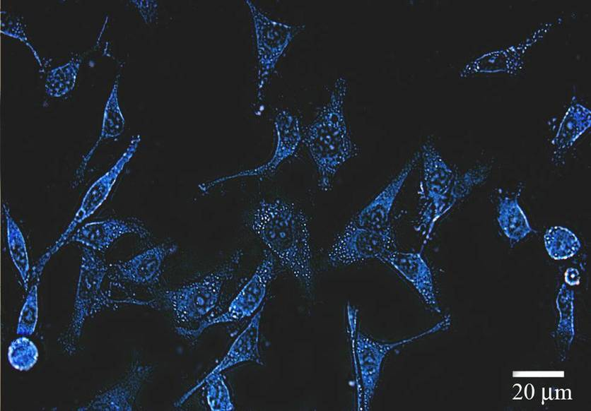
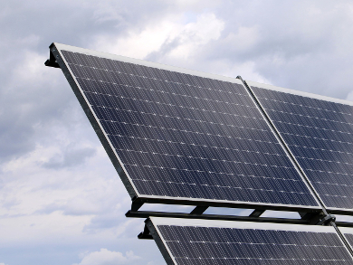
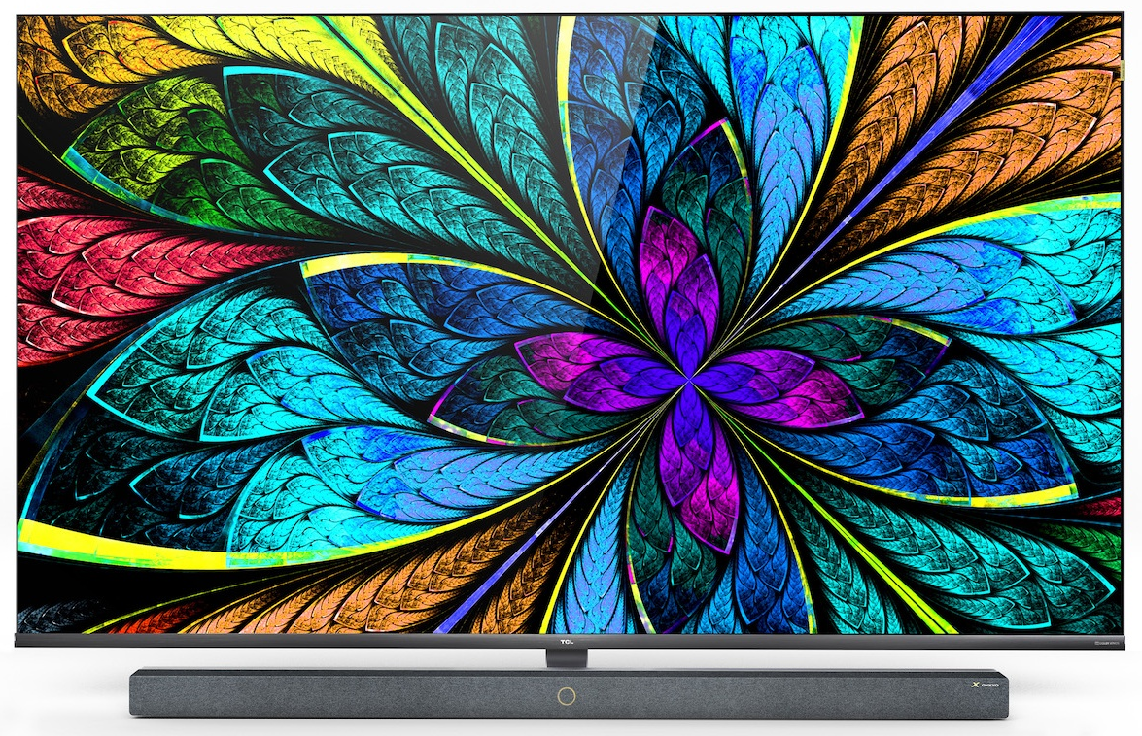
Quantum Dot Nanotechnology
Man-made nanoscale crystal semiconductors
Extremely small (takes 10,000 QDs to span width of human hair)
Convert between optical, electrical, and chemical energy
Used in solar cells, LCD/LED displays, photocatalysts, and photovoltaics, and medical imaging and therapies
https://www.graphene-info.com/graphene-quantum-dots
Dr. Richard Tilley: https://www.sciencelearn.org.
https://www.chemistryviews.org/
Notes:
Your introduction slide(s) should:
Set up your presentation with a research question, hypothesis, or general purpose statement
Include all background information relevant for your audience to understand the underlying issue.
Make sure that you define terms and keep the “level” of your audience in mind. You may be presenting to specialists in your area or the lay public. Your presentation should reflect that.
You may need more than one of these slides.

Slide 3
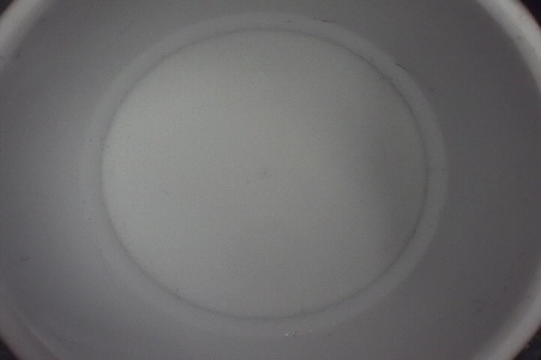
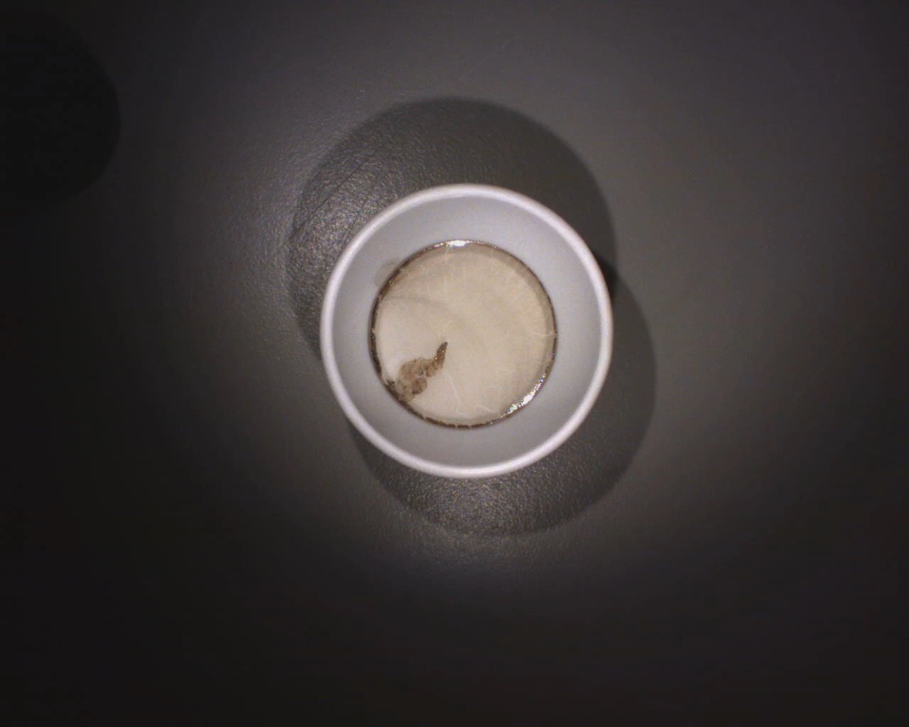
Dr. Martin McPhail, Chemistry, UWG
Dr. Martin McPhail, Chemistry, UWG
Single Quantum Dot (QD) Monolayers Deposited Over Large Areas
Self-Assembly is the
Reorganization of QDs at the Molecular Level

Slide 4
The Challenge
Researcher’s Dilemma
Chemist images a series of reactions on Quantum Dots
He manually pixelates each image to separate the nanofilms from background
His question is can we automate this process?
If so, can we also apply it to a videos which have captured the entire reaction?
Approach & Questions
The Chemistry: Understand researcher’s challenges and goals
Explore segmentation strategies / feature extraction
Could Artificial Intelligence algorithms enhance outcomes?
What mechanisms are best suited to handle feature extractions in video?
Notes:
Your introduction slide(s) should:
Set up your presentation with a research question, hypothesis, or general purpose statement
Include all background information relevant for your audience to understand the underlying issue.
Make sure that you define terms and keep the “level” of your audience in mind. You may be presenting to specialists in your area or the lay public. Your presentation should reflect that.
You may need more than one of these slides.

Slide 5
Methods
Participants
This work was a collaboration and mentorship
Dr. Karen Works, FSU, Computer Science
Dr. Martin McPhail, UWG, Chemistry
Procedure
Isolate region of interest (ROI) & crop image
Compare Segmentation Techniques
Explore AI algorithms which identify and remove unnecessary pixels in images and frames thereby enhancing efficiency
Incorporate background subtraction within videos
Dr. Martin McPhail, Chemistry, UWG
Notes:
Your research slide should give your audience a clear idea of your process
How did you conduct your study?
Again, figures are useful here.
What data sources did you use?
Were there any issues that you had to address in the data sources?

Slide 6
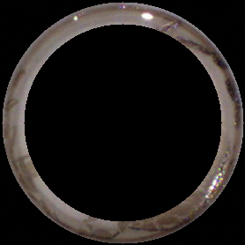
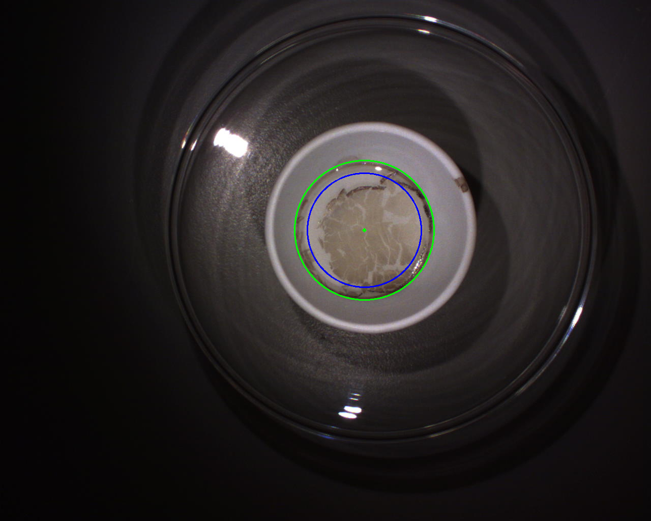
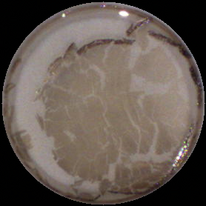
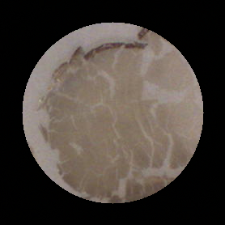
Hough Circle Transform
Meniscus Ring
(Ring)
Region of Interest
(ROI)
Area of Contraction
(AOC)
Notes:
Results should include the outcomes of your project.
For some this will statistical analyses or trendlines
For others it may be a creative product or a working computer program.
Display results in a way that makes sense to the reader (tables, graphs, charts are great)
Make sure charts are in the appropriate format.
If you are an exhibition or you do not have any results (in this case you can skip this slide or show what ever portion of results you have thus far)

Slide 7
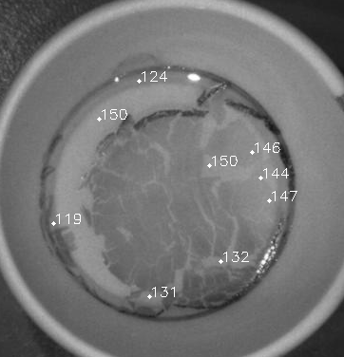
Traditional Segmentation Methods Fail
Attempted Methods
Binary Thresholding
Edge Detection Filters
Dilation / Erosion
Watershed (2D topological)
> poor segmentation results
Issues
Translucency
Low Contrast
Discontinuous Edges
Regions of Noise
Pixel Values
Grayscale
255 (white)
|
| lighter
|
|
|
| darker
|
0 (black)
Notes:
Results should include the outcomes of your project.
For some this will statistical analyses or trendlines
For others it may be a creative product or a working computer program.
Display results in a way that makes sense to the reader (tables, graphs, charts are great)
Make sure charts are in the appropriate format.
If you are an exhibition or you do not have any results (in this case you can skip this slide or show what ever portion of results you have thus far)

Slide 8
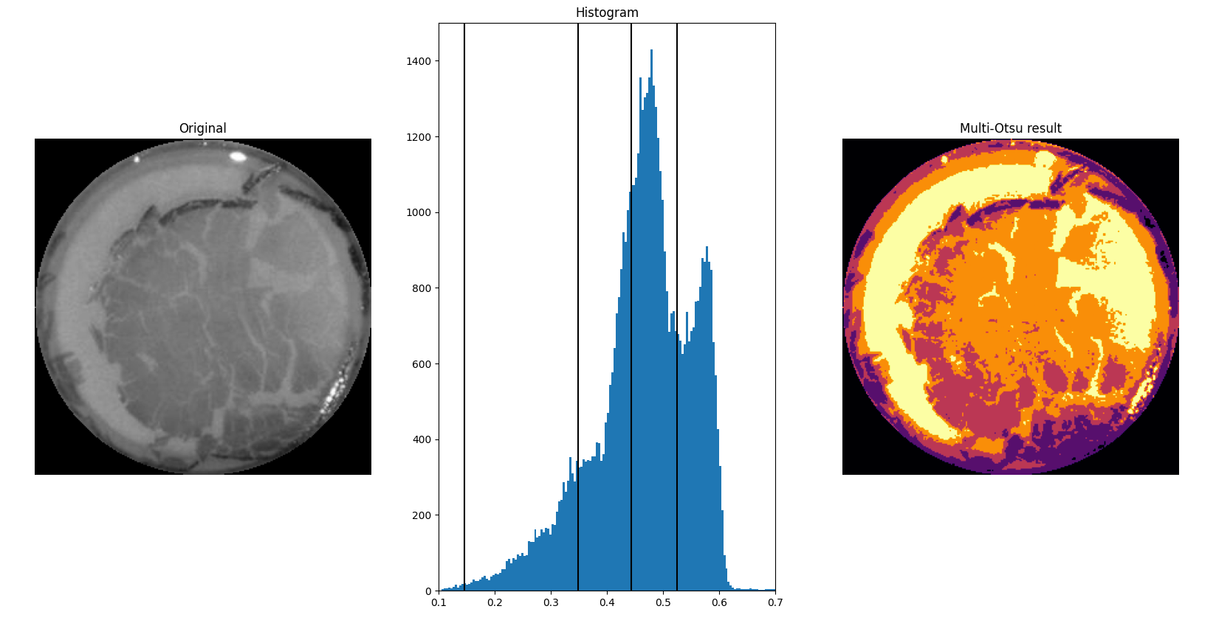
Multi-Otsu Thresholding with 5 Regions
1
2
3
4
5
Identify layers of film density to discriminate between background and foreground
Notes:
Results should include the outcomes of your project.
For some this will statistical analyses or trendlines
For others it may be a creative product or a working computer program.
Display results in a way that makes sense to the reader (tables, graphs, charts are great)
Make sure charts are in the appropriate format.
If you are an exhibition or you do not have any results (in this case you can skip this slide or show what ever portion of results you have thus far)

Slide 9
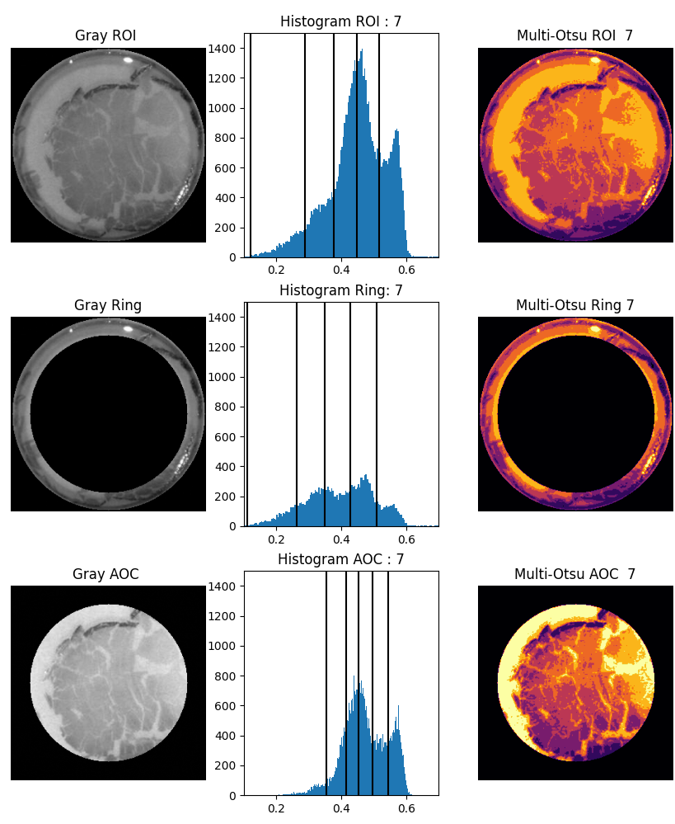
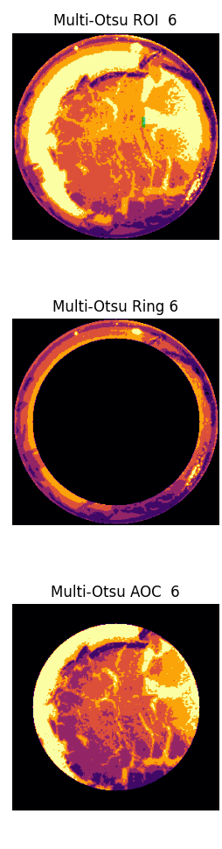
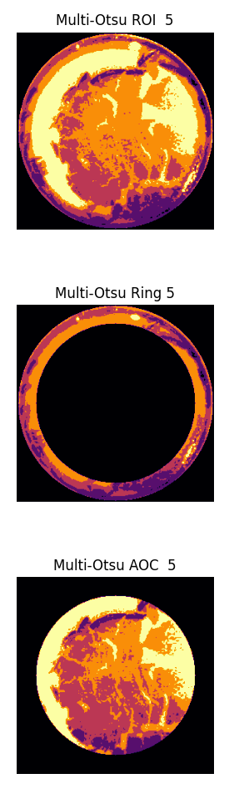
Multi-Otsu Thresholding Comparisons
Partitioning Adds Accuracy
~ But ~
Multi-Otsu Thresholding is Computationally Costly
Processing Speeds
Classes : Time
4 : 5 sec.
5 : 10 - 15 sec.
6 : 10 - 15 min.
7 : 2.5 - 3 hours
Notes:
Results should include the outcomes of your project.
For some this will statistical analyses or trendlines
For others it may be a creative product or a working computer program.
Display results in a way that makes sense to the reader (tables, graphs, charts are great)
Make sure charts are in the appropriate format.
If you are an exhibition or you do not have any results (in this case you can skip this slide or show what ever portion of results you have thus far)

Slide 10
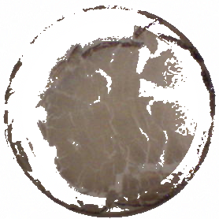
Initial Comparison
Automation
Accuracy
Manual Pixelation
33,919 px area
Process Time: ~ 2 hours
Multi-thresholding / Partitioning
35,681 px area (+5%)
Process Time: ~ 2.75 hours (if 7 classes)
Notes:
Results should include the outcomes of your project.
For some this will statistical analyses or trendlines
For others it may be a creative product or a working computer program.
Display results in a way that makes sense to the reader (tables, graphs, charts are great)
Make sure charts are in the appropriate format.
If you are an exhibition or you do not have any results (in this case you can skip this slide or show what ever portion of results you have thus far)

Slide 11
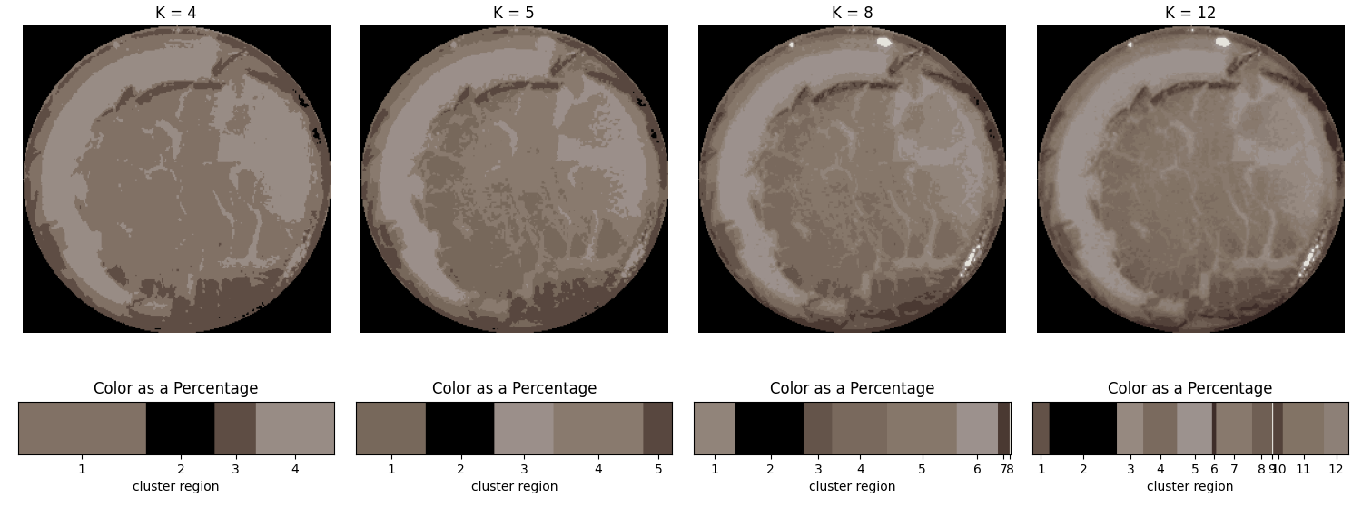
K-Means Color Quantization
Unsupervised AI Learning Algorithm
Processing Time: 2 seconds!!
Notes:
Results should include the outcomes of your project.
For some this will statistical analyses or trendlines
For others it may be a creative product or a working computer program.
Display results in a way that makes sense to the reader (tables, graphs, charts are great)
Make sure charts are in the appropriate format.
If you are an exhibition or you do not have any results (in this case you can skip this slide or show what ever portion of results you have thus far)

Slide 12
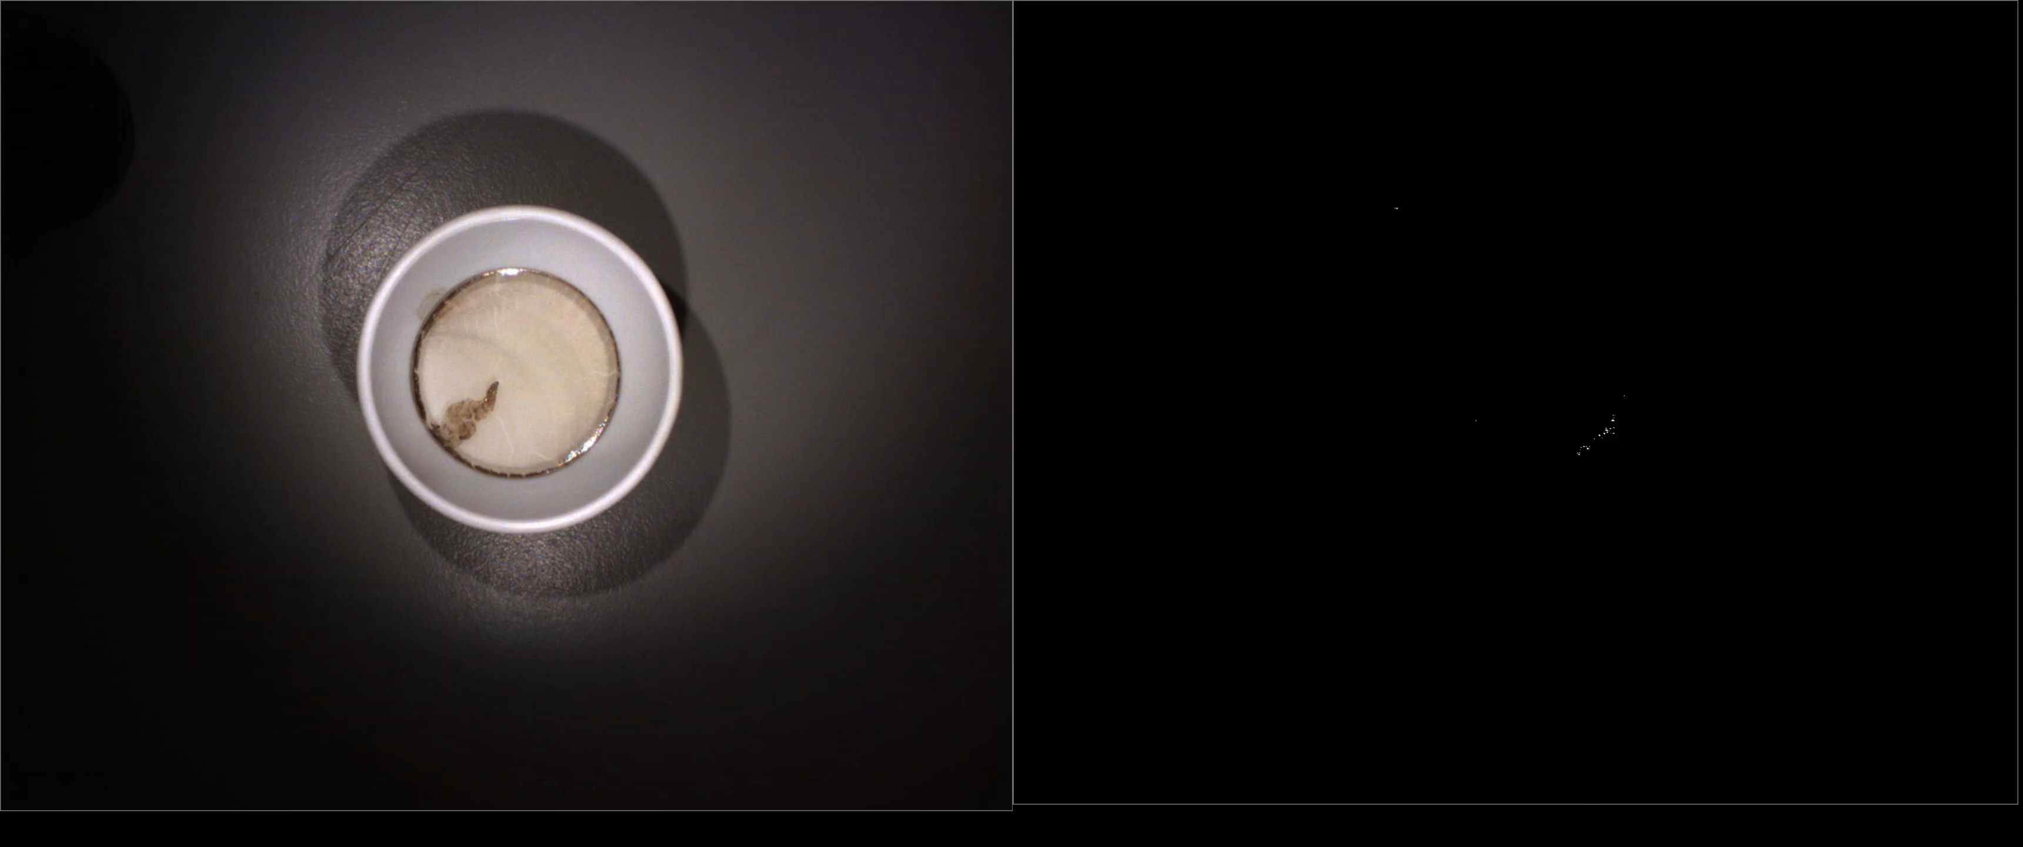
Background Subtraction with K-Nearest Neighbors
Frame by Frame Detection of Moving Pixels in Real-Time
Notes:
Results should include the outcomes of your project.
For some this will statistical analyses or trendlines
For others it may be a creative product or a working computer program.
Display results in a way that makes sense to the reader (tables, graphs, charts are great)
Make sure charts are in the appropriate format.
If you are an exhibition or you do not have any results (in this case you can skip this slide or show what ever portion of results you have thus far)

Slide 13
Conclusions
Nanofilm Imaging is a notoriously challenging process
This project offers reliable and efficient solutions for these barriers
This work is not complete and is continuing
Rebecca Carroll is joining the project to develop an intuitive web-based UI
Explore Unsupervised and Semi-Supervised learning environments to tune segmentation
Better define how time-series methods interact with user
Test-drive program in the lab
Dr. McPhail introduced this project in his recently invited talk at the Spring National American Chemical Society Meeting for its benefits to his work and perhaps other chemists

Slide 14
Dr. Karen Works, PhD. Dr. Martin McPhail, PhD. Computer Science Chemistry Florida State University West Georgia University Project Advisor Quantum Dot Research
Thank You!
A special thank you to Drs. Works and McPhail for their mentorship and for offering such a valuable insight producing gains we did not initially foresee
Notes:
Conclusion slide lets your audience know that you are done.

Slide 15
References
Ding, Yu & Bukkapatnam, Satish. (2015). Challenges and needs for automating nano image processing for material characterization. 95560Z. 10.1117/12.2186251. Hughes A, Liu Z, Raftari M,
Reeves ME. (2014). A workflow for characterizing nanoparticle monolayers for biosensors: Machine learning on real and artificial SEM images. PeerJ PrePrints 2:e671v2 https://doi.org/10.7287/peerj.preprints.671v2
Huang, D.Y., Lin, T.W. and Hu, W.C. (2011) Automatic Multilevel Thresholding Based on Two-Stage Otsu’s Method with Cluster Determination by Valley Estimation. ICIC International Journal of Innovative Computing, Information and Control, 7, 5631-5644.
Liao, Ping-Sung & Chen, Tse-Sheng & Chung, Pau-Choo. (2001). A Fast Algorithm for Multilevel Thresholding.. J. Inf. Sci. Eng.. 17. 713-727.

Slide 16
And You Thought it was the End… Extra slides for questions of details under the hood
Notes:
This page should consist of only the relevant information for the study

Slide 17
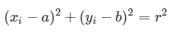
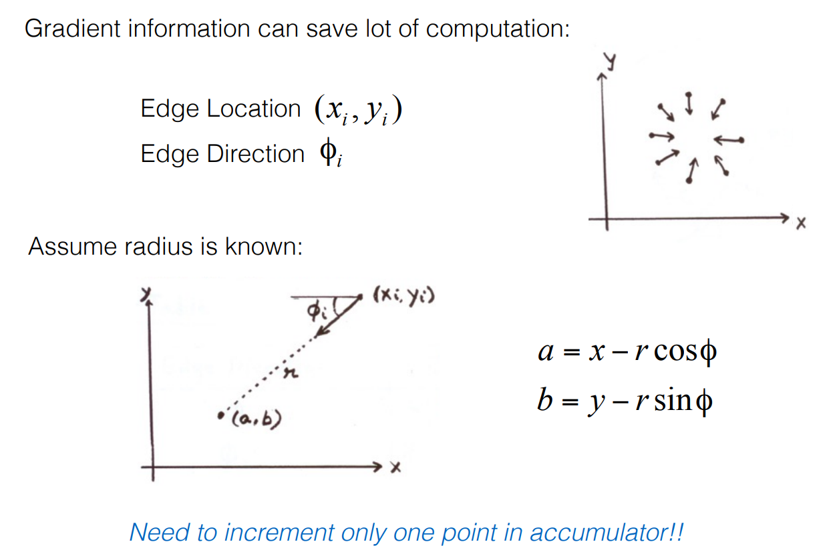
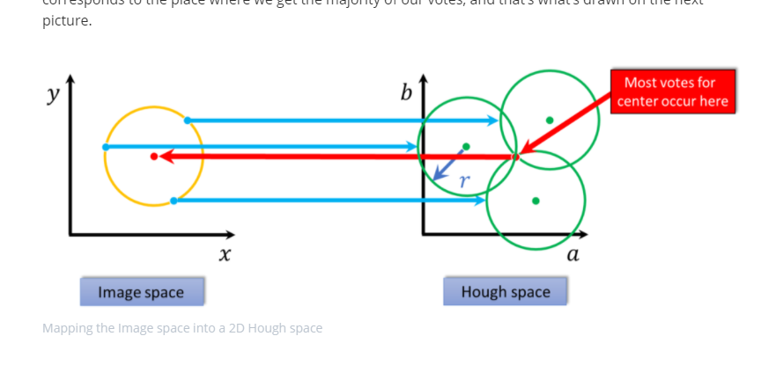
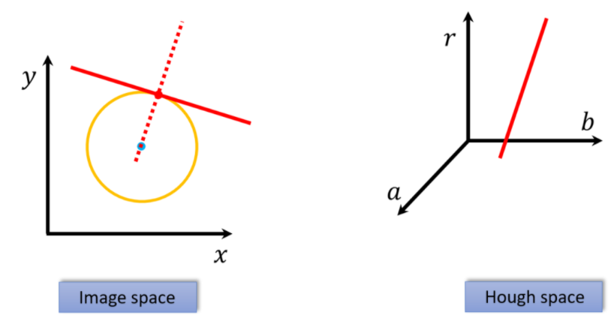
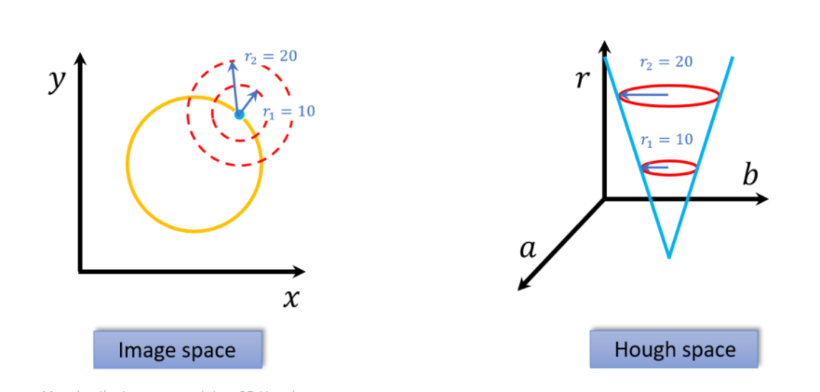
Feature Extraction with Hough Circle Transform and Hough Gradient
Equation for Circle:
Hough Circle works based on ‘votes’ to define the probable center of a circle.
If we know the radius and the gradient of a point in an edge, then there is only one possible circle for which this would define. Any radius for that gradient would fall somewhere upon the line.
Hough Gradient increases speed of algo
Step 1: Compute edges in image
Step 2: Map points on these edge from image space to the Hough parametric space
Unknown radius can still be determined by the parametric space as various radii from center create cone
http://datahacker.rs/
Notes:
Results should include the outcomes of your project.
For some this will statistical analyses or trendlines
For others it may be a creative product or a working computer program.
Display results in a way that makes sense to the reader (tables, graphs, charts are great)
Make sure charts are in the appropriate format.
If you are an exhibition or you do not have any results (in this case you can skip this slide or show what ever portion of results you have thus far)

Slide 18
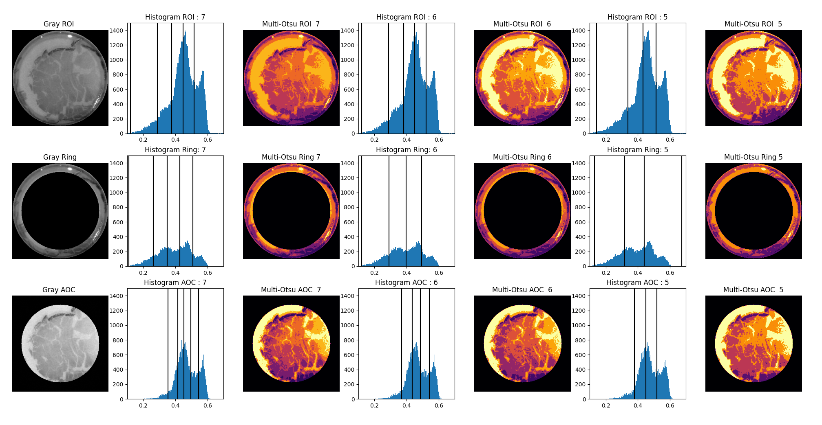
Multi-Otsu Thresholding with Histograms
Notes:
Results should include the outcomes of your project.
For some this will statistical analyses or trendlines
For others it may be a creative product or a working computer program.
Display results in a way that makes sense to the reader (tables, graphs, charts are great)
Make sure charts are in the appropriate format.
If you are an exhibition or you do not have any results (in this case you can skip this slide or show what ever portion of results you have thus far)

Slide 19
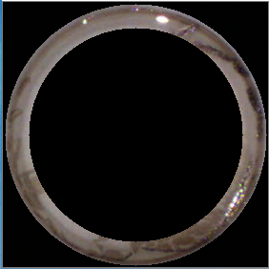
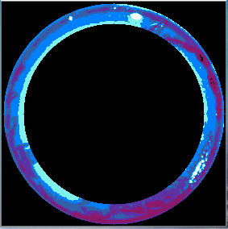
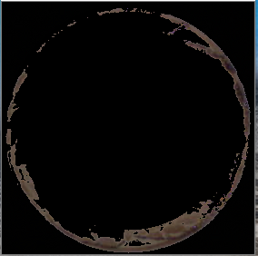
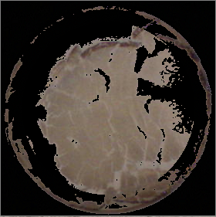
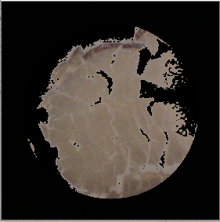
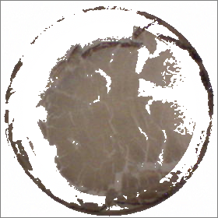
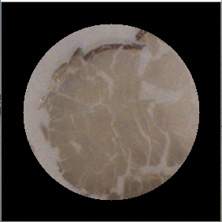
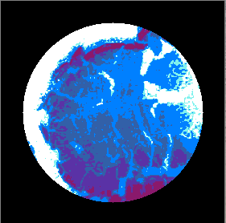
Manual Adjustment of Multi-Thresholding Technique
Select Desired Regions
Recombine
OR
Final Segments
Notes:
Results should include the outcomes of your project.
For some this will statistical analyses or trendlines
For others it may be a creative product or a working computer program.
Display results in a way that makes sense to the reader (tables, graphs, charts are great)
Make sure charts are in the appropriate format.
If you are an exhibition or you do not have any results (in this case you can skip this slide or show what ever portion of results you have thus far)

Slide 20
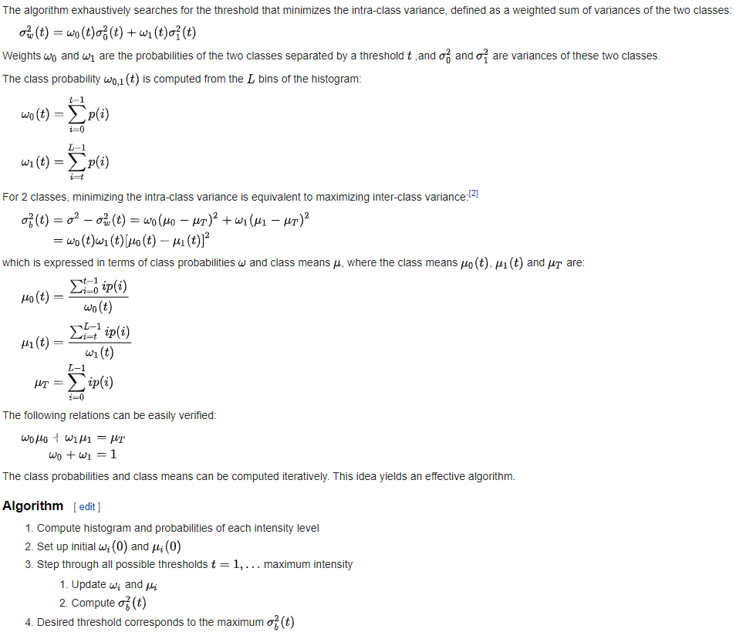
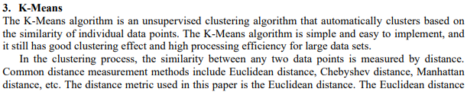
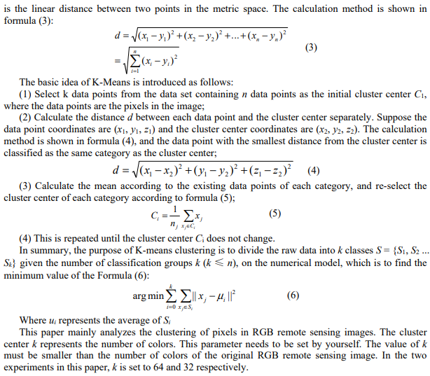
Multi-Otsu Thresholding K-Means Color Quantization
Multi-Otsu Thresholding tends to run so many more iterations due to summation calculations and k-means limits unnecessary iterations.
The number of objects that change cluster is smaller than a given threshold
wikipedia.org
Guojian Cheng and Junjie Wei 2019 J. Phys.: Conf. Ser. 1213 042012
Notes:
Results should include the outcomes of your project.
For some this will statistical analyses or trendlines
For others it may be a creative product or a working computer program.
Display results in a way that makes sense to the reader (tables, graphs, charts are great)
Make sure charts are in the appropriate format.
If you are an exhibition or you do not have any results (in this case you can skip this slide or show what ever portion of results you have thus far)

Slide 21
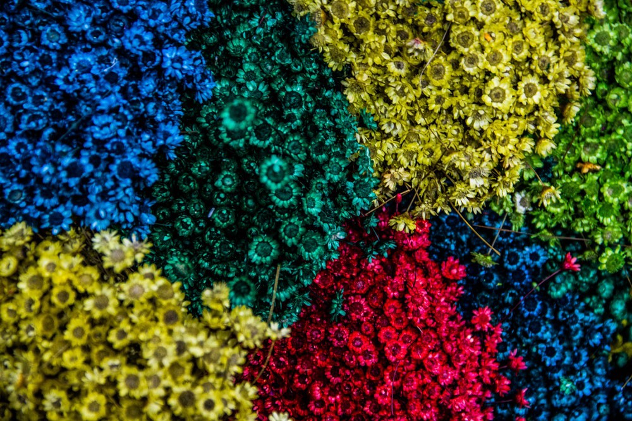
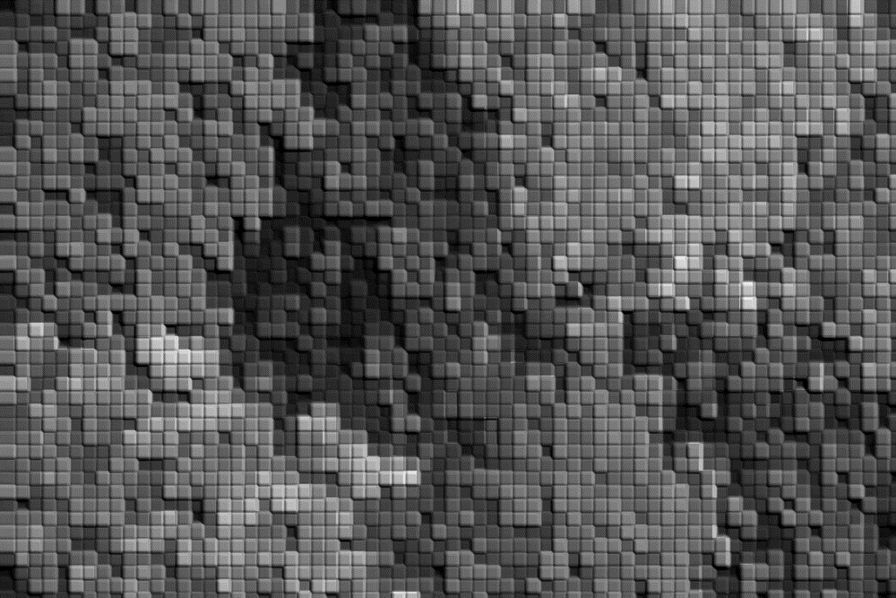
Color Quantization with k-means
Seed 1
Seed 2
Seed 3
Seed 4
Seed 5
Step 4: For each iteration, the average color is calculated for each cluster group thereby shifting the centroid toward the true center of the cluster. This step-wise behavior is seen above.
Step 5: Iterate again over image with newly defined centroids and recalculate variances from each pixel value with centroid and make sure it’s still in correct cluster.
Step 6: iterate set number of times or until the variance (epsilon) is reached. All pixels in each cluster are converted to the color value of the centroid, thus reducing the image to k-values.
Step 1: define k value of clusters ( K = 5 )
Step 2: k number of pixel values are chosen (centroids) called ‘seeds’ to start for comparison
Step 3: Iterate through each data point (pixel) and determine through variances in color which cluster that pixel belongs and designate it.
C
1
C
2
C
3
C
4
C
5
Notes:
Results should include the outcomes of your project.
For some this will statistical analyses or trendlines
For others it may be a creative product or a working computer program.
Display results in a way that makes sense to the reader (tables, graphs, charts are great)
Make sure charts are in the appropriate format.
If you are an exhibition or you do not have any results (in this case you can skip this slide or show what ever portion of results you have thus far)

Slide 22
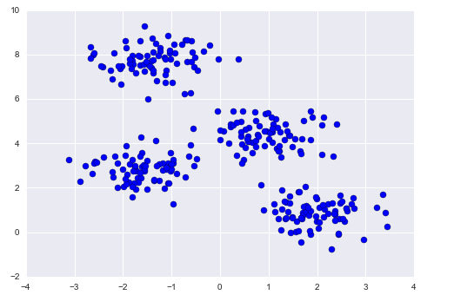

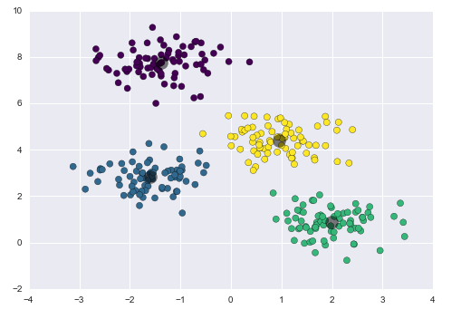
Color Quantization with k-means
Step 1: define k value of clusters
Step 2: k number of random (or not) pixel values are chosen (centroids)
Step 3: Iterate through each data point (pixel) and determine through variances in color which cluster that pixel belongs and designate it.
Step 4: For each cluster, now calculate the average color and this becomes the new centroid / center for that cluster.
Step 5: Iterate through pixels with newly defined centroids and make sure each pixel is still within its proper cluster.
This process continues through a determined number of iterations or until the accuracy (epsilon) is reached stopping the program
https://upload.wikimedia.org/wikipedia/commons/e/ea/K-means_convergence.gif
Notes:
Results should include the outcomes of your project.
For some this will statistical analyses or trendlines
For others it may be a creative product or a working computer program.
Display results in a way that makes sense to the reader (tables, graphs, charts are great)
Make sure charts are in the appropriate format.
If you are an exhibition or you do not have any results (in this case you can skip this slide or show what ever portion of results you have thus far)

